Slide 1
Capstone Engagement
Assessment, Analysis, and Hardening of a Vulnerable System Report by: Ian Duff
Ian Duff – Red Team vs Blue Team Pen Testing and SoC Analysis Project

Slide 2
Table of Contents
This document contains the following sections:
01
Network Topology
02
Red Team: Security Assessment
03
Blue Team: Log Analysis and Attack Characterization
Hardening: Proposed Alarms and Mitigation Strategies
04
Ian Duff – Red Team vs Blue Team Pen Testing and SoC Analysis Project

Slide 3
Network Topology
3

Slide 4
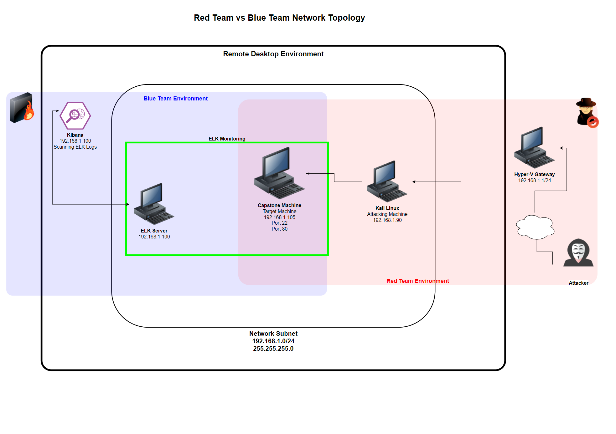
Network Topology
Network
Address Range: 192.168.1.1
Netmask: 255.255.255.0
Gateway:
Machines
IPv4: 192.168.1.1
OS: Windows 10
Hostname: Azure Hyper_V
IPv4: 192.168.1.90
OS: Linux
Hostname: Kali
IPv4: 192.168.1.100
OS: Linux
Hostname: ELK-Stack
IPv4: 192.168.1.105
OS: Linux
Hostname: Capstone
Ian Duff – Red Team vs Blue Team Pen Testing and SoC Analysis Project

Slide 5

Red Team
Security Assessment
Ian Duff – Red Team vs Blue Team Pen Testing and SoC Analysis Project
5

Slide 6
Recon: Describing the Target
Nmap identified the following hosts on the network:
Hostname | IP Address | Role on Network
Hyper_V Azure Machine | 192.168.1.1 | Cloud-Based Host Machine - Gateway
Kali Linux Machine | 192.168.1.90 | Attacking Machine (Red Team)
ELK Stack Machine | 192.168.1.100 | Monitoring and Logging with Kibana
Capstone Machine | 192.168.1.105 | Target Machine
Ian Duff – Red Team vs Blue Team Pen Testing and SoC Analysis Project

Slide 7
Vulnerability Assessment
The assessment uncovered the following critical vulnerabilities in the target:
Vulnerability | Description | Impact
CWE-312: Cleartext Storage of Sensitive Information | Usernames, sensitive directory file paths, and unsalted password hashes are stored on webserver in plain text. | Attackers are provided easy access to sensitive information and systems. Attacker can potentially launch several different types of attacks with this access.
CWE-522: Insufficiently Protected Credentials | Unsalted password hashes with outdated md5 encryption are easily cracked. Weak passwords are easily brute forced. | Attackers can quickly crack or brute force passwords with poor protection in seconds.
CWE-434: Unrestricted Upload of File with Dangerous Type | Malicious shell script uploaded to webserver. | Shell script allows attacker unrestricted remote access through the use of a reverse shell.
Ian Duff – Red Team vs Blue Team Pen Testing and SoC Analysis Project

Slide 8
Exploitation: CWE-312
01
02
03
Web Browser
Navigation of directories to gather sensitive information stored in cleartext. Information provided directory paths and login credentials necessary for gaining access to system.
Achievements
Identified secret company folder. Acquired login usernames. Combined usernames with brute forced password and cracked password hash to gain access to WebDAV and upload reverse shell script.
Secret Directory Location
http://192.168.1.105/company_folders/secret_folder/
Ian Duff – Red Team vs Blue Team Pen Testing and SoC Analysis Project

Slide 9
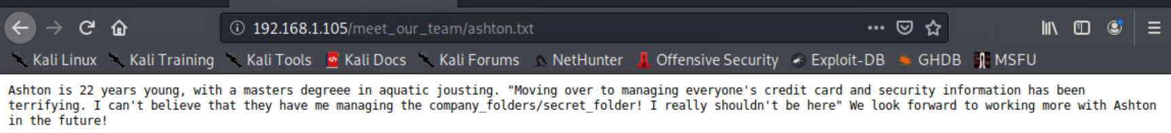
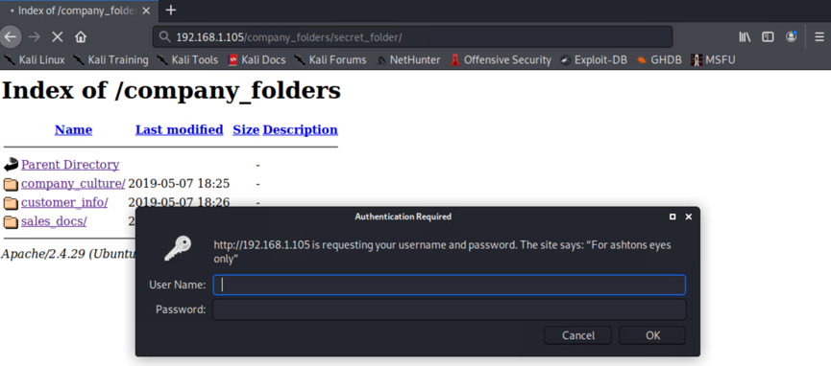
Exploitation: CWE-312 (identify usernames and directory)
Ian Duff – Red Team vs Blue Team Pen Testing and SoC Analysis Project

Slide 10
Exploitation: CWE-552
01
02
03
Hydra
Brute forced password for login username identified in previous exploitation (CWE-312)
CrackStation.net
Cracked unsalted password hash acquired from file accessed using recently acquired login username and brute forced password.
Achievements
The brute forced password provided access to a password file using Ashton’s account. Login credentials provided ssh access and access to a file with a login username and unsalted password hash. Cracking the hash provided access to the WebDAV system and allowed for the uploading of a shell script.
hydra –l ashton –P /usr/share/wordlists/rockyou.txt –s 80 –f –vV 192.168.1.105 http-get “/company_folders/secret_folder”
Ian Duff – Red Team vs Blue Team Pen Testing and SoC Analysis Project

Slide 11
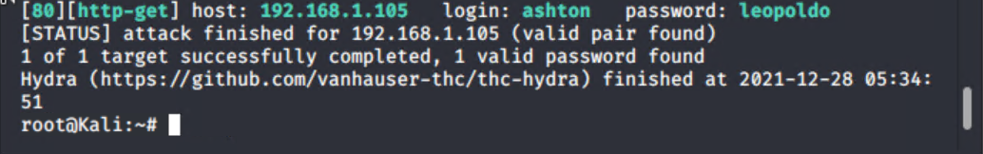
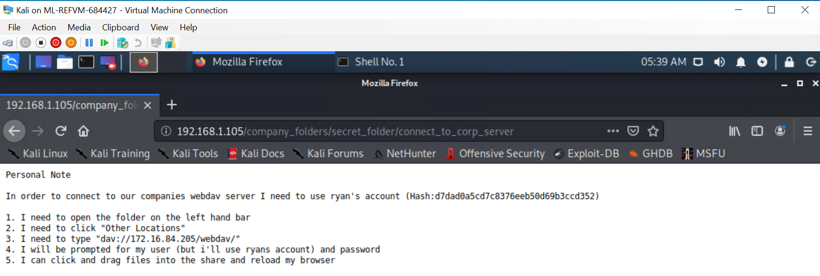
Exploitation: CWE-552 (Hydra brute force attack)
Ian Duff – Red Team vs Blue Team Pen Testing and SoC Analysis Project

Slide 12
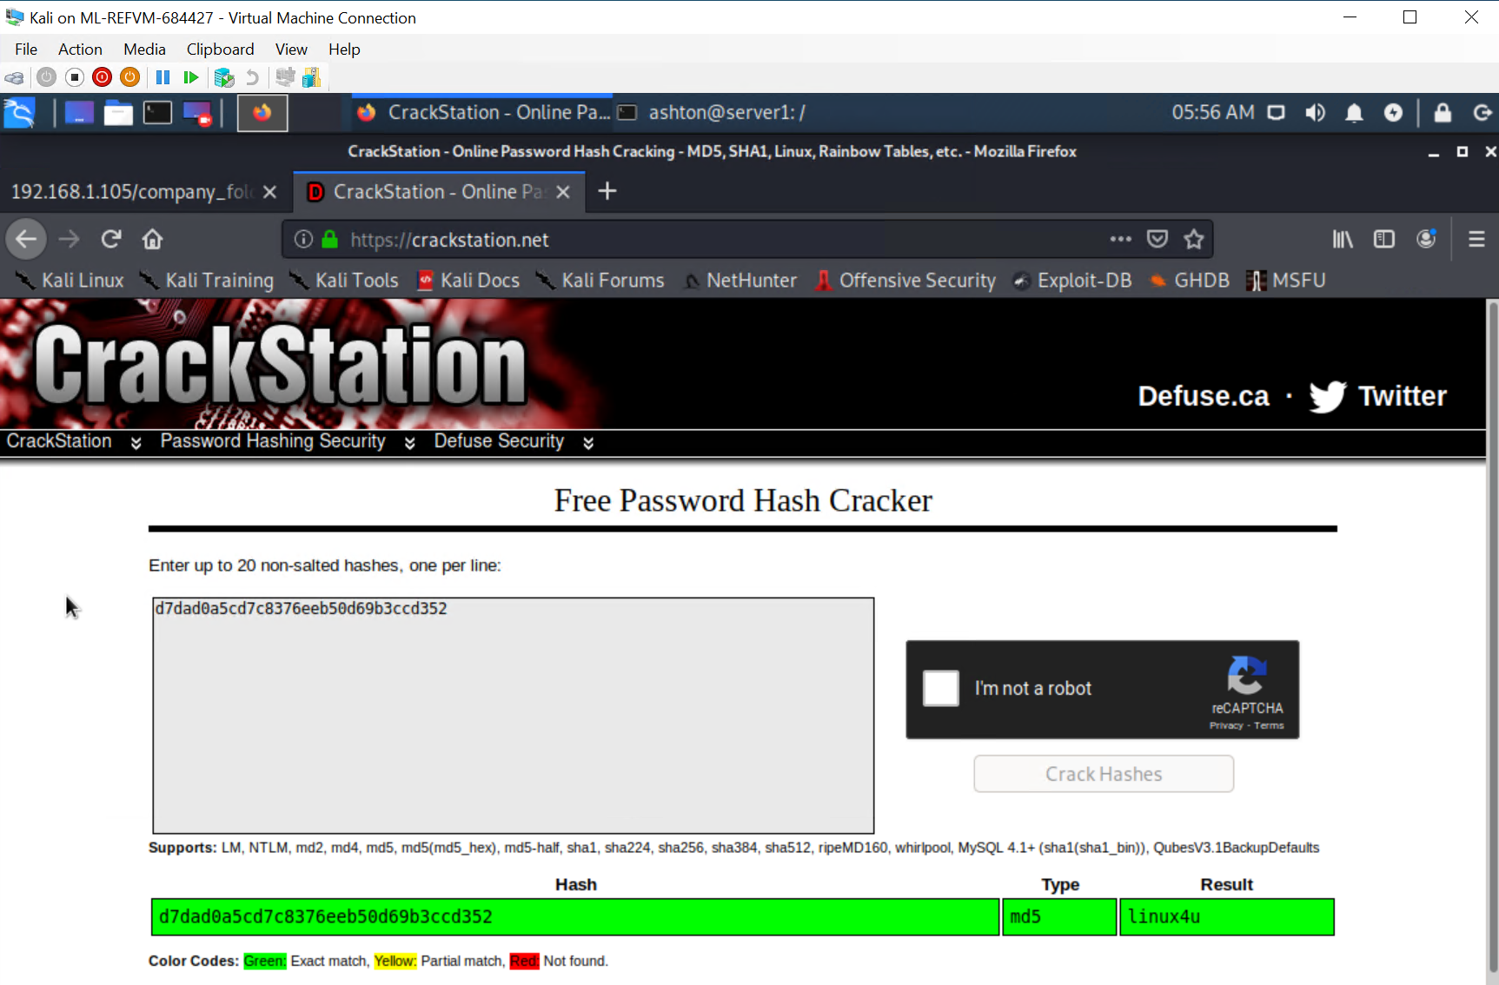
Exploitation: CWE-552 (crack password hash)
Ian Duff – Red Team vs Blue Team Pen Testing and SoC Analysis Project

Slide 13
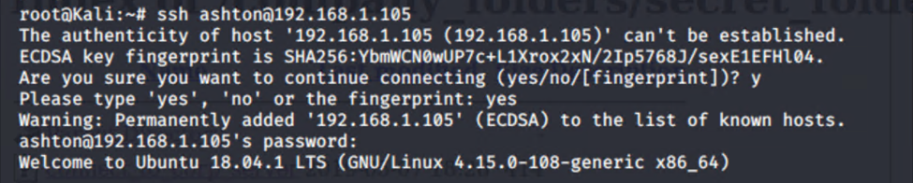
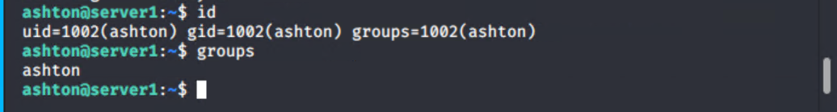
Exploitation: CWE-552 (ssh into “server1”)
Ian Duff – Red Team vs Blue Team Pen Testing and SoC Analysis Project

Slide 14
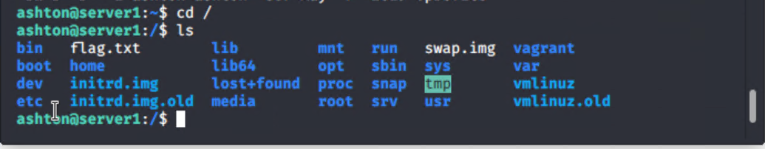
Exploitation: CWE-552 (collect flag #1 using ssh)
Ian Duff – Red Team vs Blue Team Pen Testing and SoC Analysis Project

Slide 15
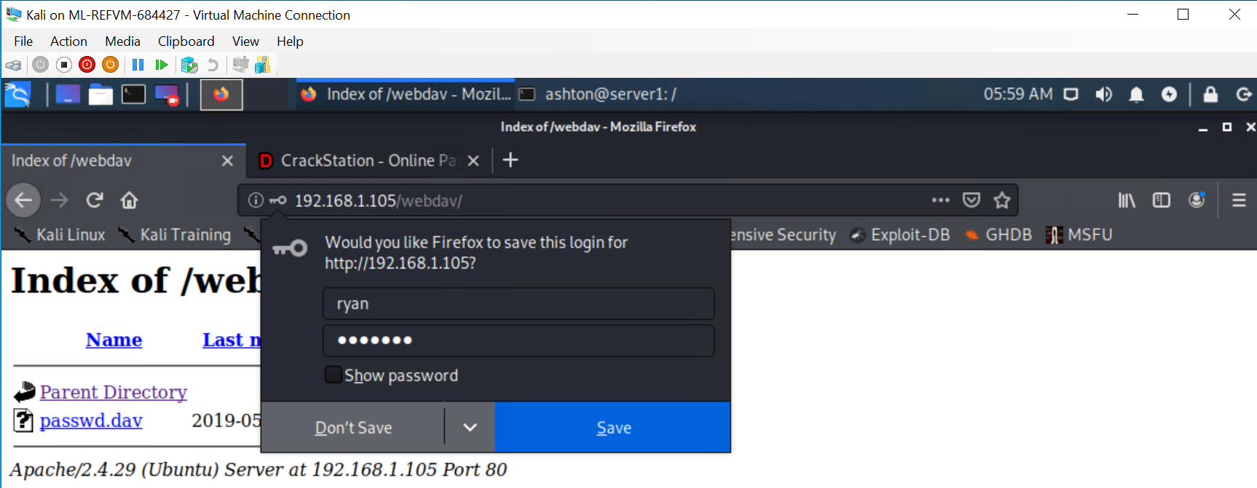
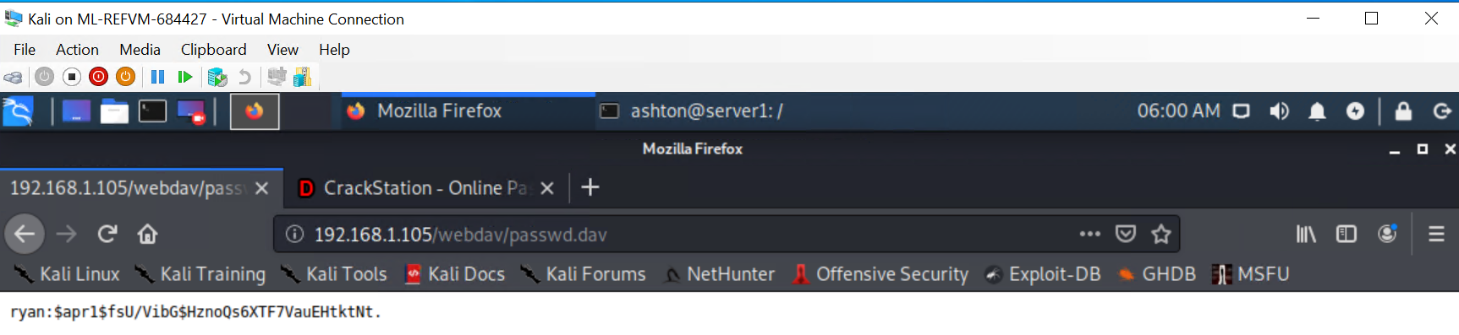
Exploitation: CWE-552 (access password file)
Ian Duff – Red Team vs Blue Team Pen Testing and SoC Analysis Project

Slide 16
Exploitation: CWE-434 [Unrestricted Upload of Dangerous File]
01
02
Msfvenom
Created a shell script payload
Cadaver
Uploaded the payload to WebDAV
Metasploit
How did you exploit the vulnerability? Which tool (Nmap, etc.) or techniques (XSS, etc.) did you use?
Achievements
Crteated a shell script payload to upload to WebDAV server on target machine.
Uploaded payload to WebDAV server.
Launched listener and set listener host and listerner port. Gained remote access to WebDAV system. Used remote access to locate flag #2 on target server and exfiltrate flag#2 to Kali machine.
Ian Duff – Red Team vs Blue Team Pen Testing and SoC Analysis Project

Slide 17
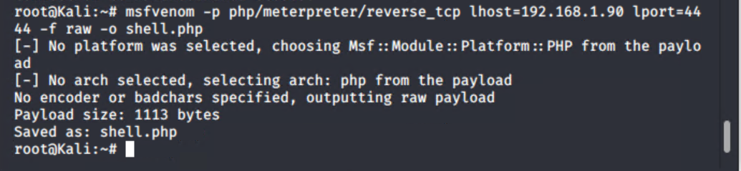
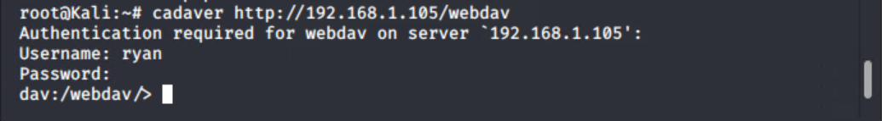
Exploitation: CWE-434 (create and upload script payload)
Ian Duff – Red Team vs Blue Team Pen Testing and SoC Analysis Project

Slide 18
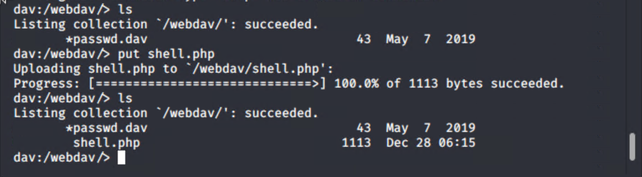
Exploitation: CWE-434 (create and upload script payload)
Ian Duff – Red Team vs Blue Team Pen Testing and SoC Analysis Project

Slide 19
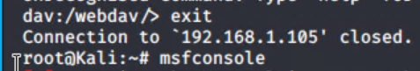

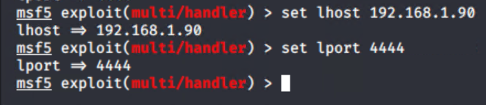
Exploitation: CWE-434 (setup listener)
Ian Duff – Red Team vs Blue Team Pen Testing and SoC Analysis Project

Slide 20
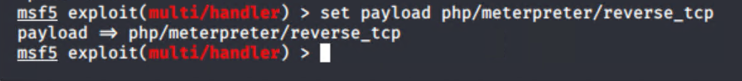
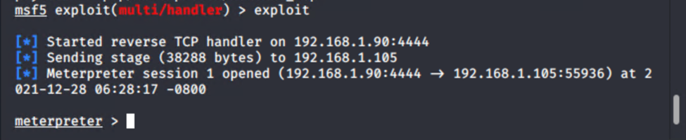
Exploitation: CWE-434 (exploit)
Ian Duff – Red Team vs Blue Team Pen Testing and SoC Analysis Project

Slide 21
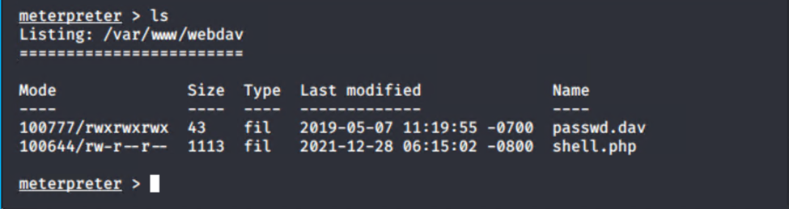
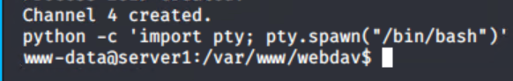
Exploitation: CWE-434 (gain interactive meterpreter shell)
Ian Duff – Red Team vs Blue Team Pen Testing and SoC Analysis Project

Slide 22
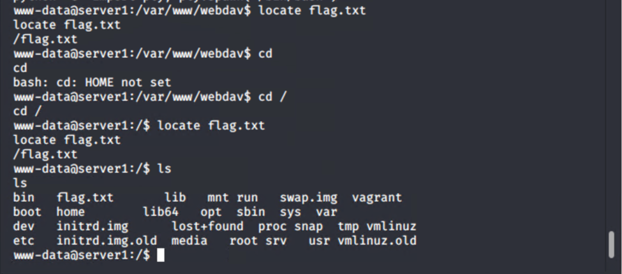
Exploitation: CWE-434 (find and exfiltrate flag #2)
Ian Duff – Red Team vs Blue Team Pen Testing and SoC Analysis Project

Slide 23
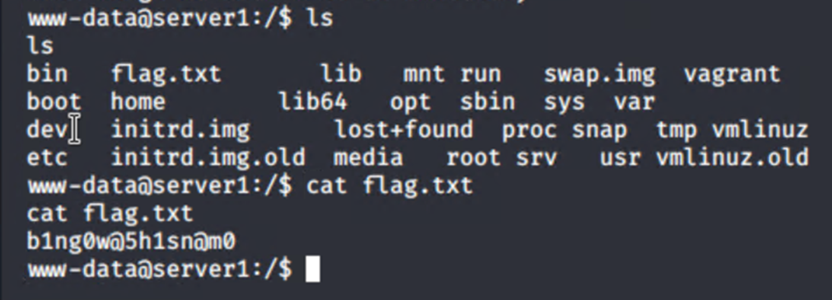
Exploitation: CWE-434 (find and exfiltrate flag #2)
Ian Duff – Red Team vs Blue Team Pen Testing and SoC Analysis Project

Slide 24
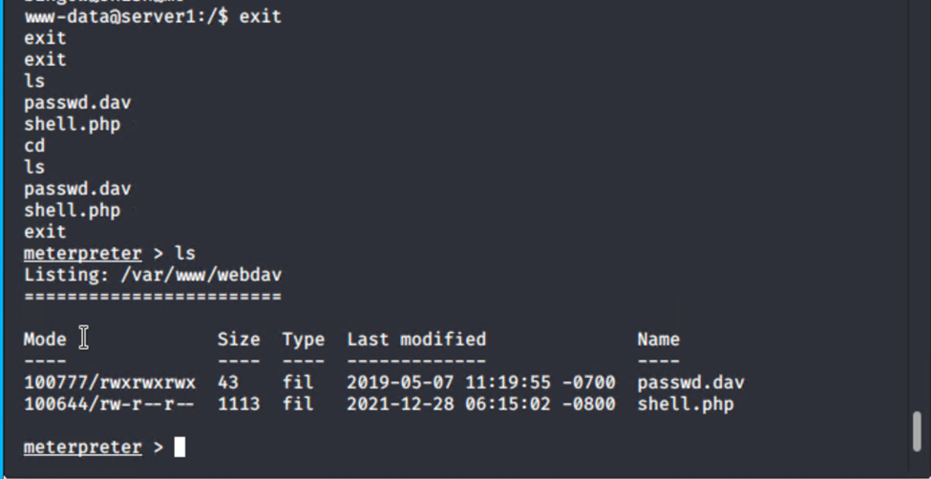
Exploitation: CWE-434 (find and exfiltrate flag #2)
Ian Duff – Red Team vs Blue Team Pen Testing and SoC Analysis Project

Slide 25
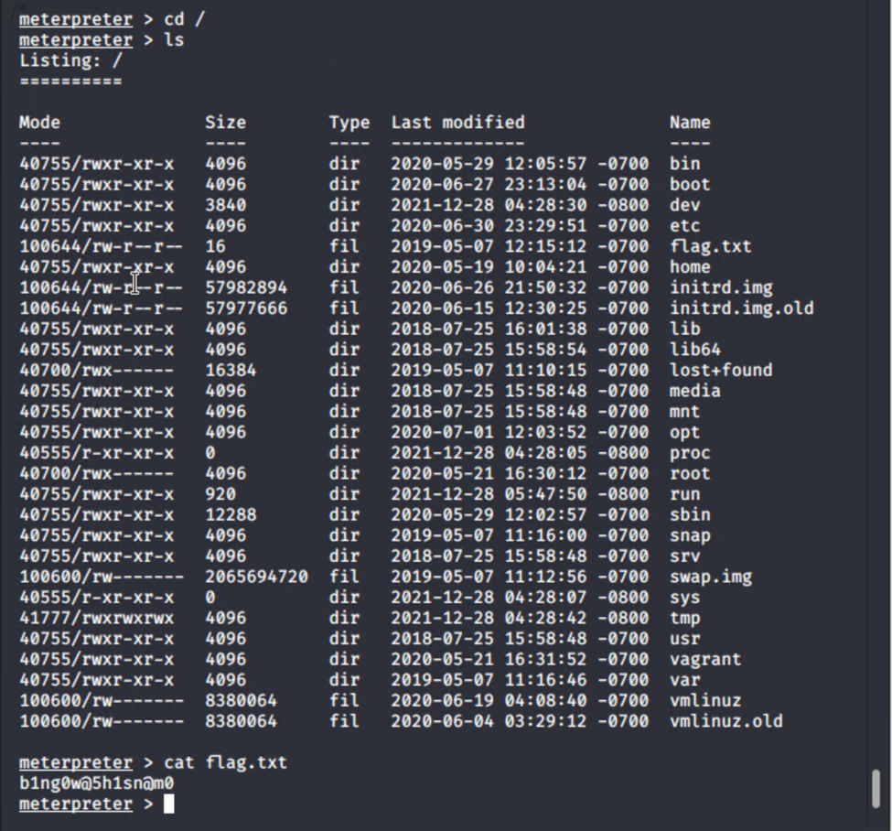
Exploitation: CWE-434 (find and exfiltrate flag#2)
Ian Duff – Red Team vs Blue Team Pen Testing and SoC Analysis Project

Slide 26
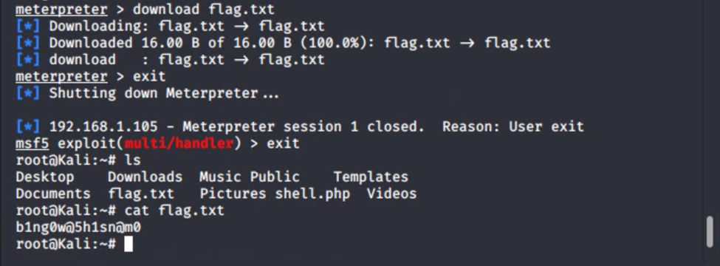
Exploitation: CWE-434 (find and exfiltrate flag#2)
Ian Duff – Red Team vs Blue Team Pen Testing and SoC Analysis Project

Slide 27

Blue Team
Log Analysis and Attack Characterization
27

Slide 28
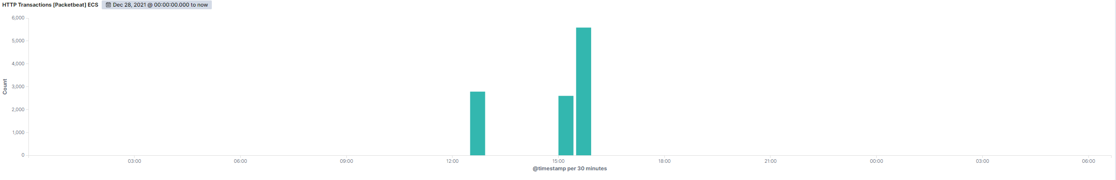

Analysis: Identifying the Port Scan
Port scans occurred at 12:30, 15:00, and 15:30 on 28 December 2021.
Packets were sent from 192.168.1.90 to 192.168.1.105. 2,784 packets, 2,599 packets, and 5,585 packets were sent respectively.
‘Mozilla/5.0 (compatible; Nmap Scripting Engine; https://nmap.org/book/nse.html’ indicates this was a port scan
Ian Duff – Red Team vs Blue Team Pen Testing and SoC Analysis Project

Slide 29
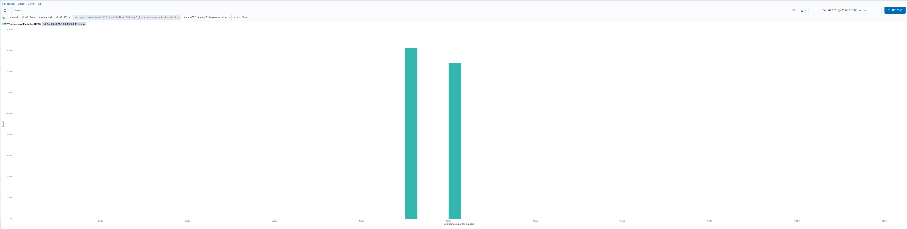
Analysis: Finding the Request for the Hidden Directory
31,064 requests were sent from 192.168.1.90 to 192.168.1.105 at made to the secret directory at 13:33:30 and 15:14:00 on 28 December 2021.
HTML text files in ISO character set were requested. The files contained login credentials and instructions for connecting to the company WebDAV server..
Ian Duff – Red Team vs Blue Team Pen Testing and SoC Analysis Project

Slide 30
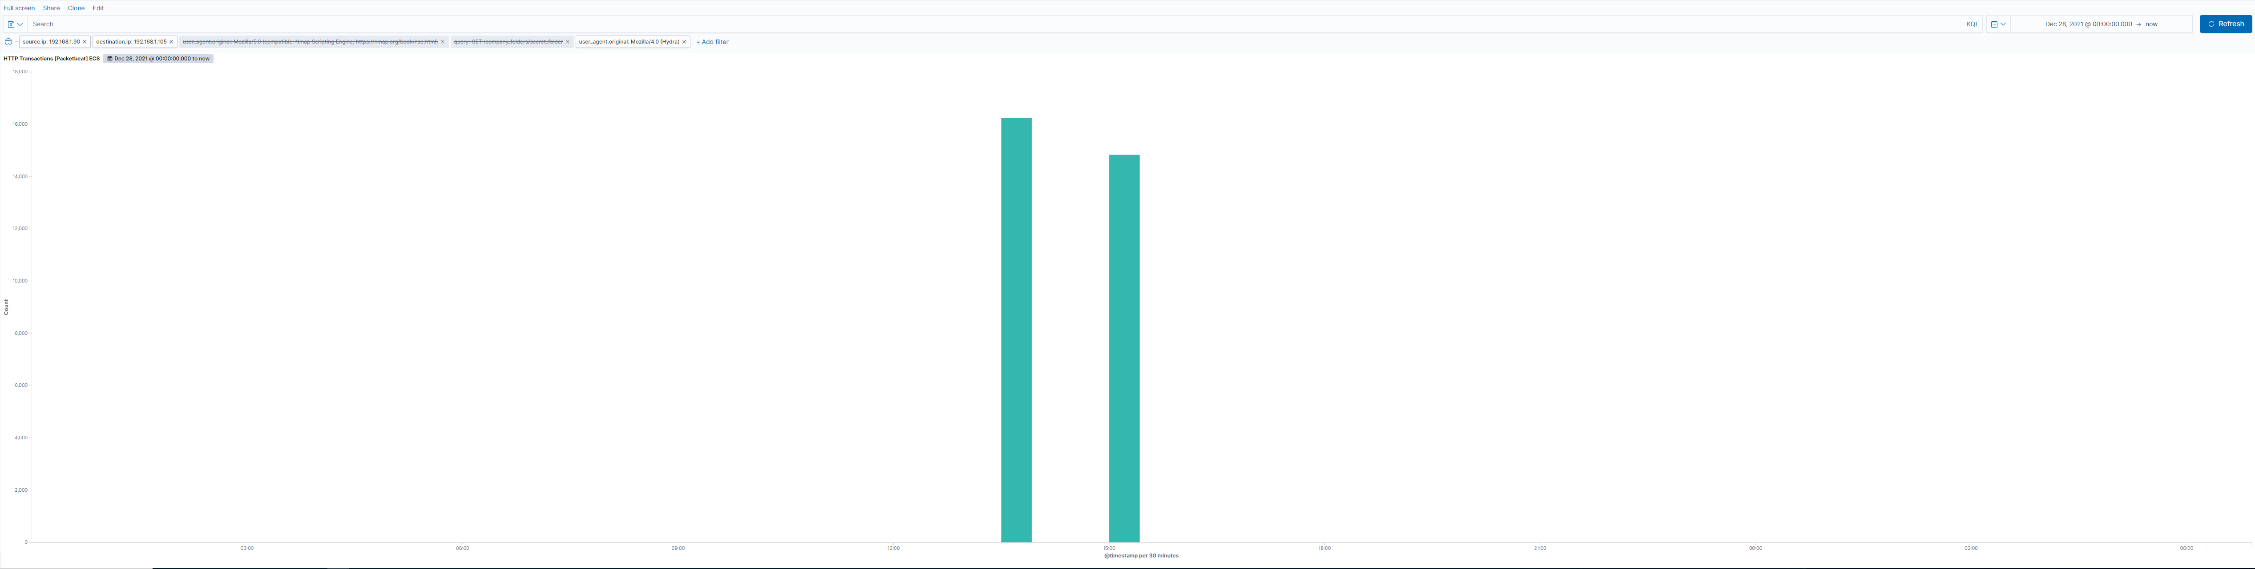
Analysis: Uncovering the Brute Force Attack
Two brute force attacks occurred at 13:30 to 13:34 and at 15:12:55 to 15:14:00 with 31,064 packet requests sent from 192.168.1.90 to 192.168.1.105. What time did the port scan occur?
The first attack made 16,236 requests before discovering the password. The second attack made 14,828 requests before discovering the password.
Ian Duff – Red Team vs Blue Team Pen Testing and SoC Analysis Project

Slide 31
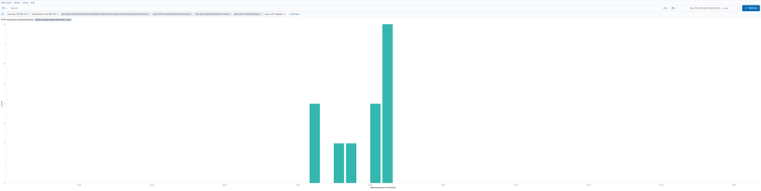
Analysis: Finding the WebDAV Connection
20 requests were made to the WebDAV directory. The requests were for the shell.php file.
Ian Duff – Red Team vs Blue Team Pen Testing and SoC Analysis Project

Slide 32
Blue Team
Proposed Alarms and Mitigation Strategies
32

Slide 33
Mitigation: Blocking the Port Scan
Create an alert for port traffic with a threshold high enough to compensate for regular traffic. Trigger the alert if the threshold is reached, common port scanning tools, or aggressive port scanning is detected.
Have a low threshold around 10 for port scanning and an upper threshold near 100 for abnormally high traffic.
The network can be configured so that susceptible ports open to external traffic are outside a firewall. Whitelist authorized IPs, block unauthorized IPs, and maintain up-to-date monitoring and security software.
Ian Duff – Red Team vs Blue Team Pen Testing and SoC Analysis Project

Slide 34
Mitigation: Finding the Request for the Hidden Directory
Create a whitelist of Ips authorized to access the hidden directory. Trigger an alarm if whitelisted IPs fail 3 login attempts in quick succession. Trigger the alert if non-whitelisted IPs attempt to access the hidden directory.
Configure the host to timeout IP addresses the are not whitelisted and IPs that exceed the login threshold. Access to a hidden directory should be minimized as much as possible. Implement robust password practices such as character limits and frequent changes.
Ian Duff – Red Team vs Blue Team Pen Testing and SoC Analysis Project

Slide 35
Mitigation: Preventing Brute Force Attacks
Establish a baseline for normal frequency of traffic over time. Trigger an alarm if the upper threshold is exceeded. Threshold should be ten failed logins.
Lockout IP addresses the fail login attempts in rapid succession. Enforce best password practices. Configure automated monitoring and logging systems to analyze large volumes of traffic and quickly identify suspicious traffic. Employ MFA.
Ian Duff – Red Team vs Blue Team Pen Testing and SoC Analysis Project

Slide 36
Mitigation: Detecting the WebDAV Connection
Create alarm that triggers whenever any non-whitelisted IP or traffic from unknown sources attempts to communicate with WebDAV system. Threshold is one.
Maintain all WebDAV systems inside of a firewall. Remove WebDAV systems from any direct connection to external traffic. Place a frequently-updated monitoring system and security system inbetweeen WebDAV systems and all other systems. Limit user access to WebDAV.
Do not use WebDAV.
Ian Duff – Red Team vs Blue Team Pen Testing and SoC Analysis Project

Slide 37
Mitigation: Identifying Reverse Shell Uploads
Create an alarm that triggers if any scripts or suspicious extensions are uploaded.
Maintain anti-virus and anti-malware software. Maintain monitoring and logging systems to identify suspicous traffic or activity. What configuration can be set on the host to block file uploads? Do not allow files to be uploaded to systems directly connected to sensitive internal network.

